Slide 1

Zomato Restaurant Analysis Chethan kalyan

Slide 2

Introduction to Zomato
User Base
Zomato has a large and diverse user base, with millions of active users worldwide. It is available in multiple countries and supports multiple languages, making it accessible to a global audience.
History
Zomato was founded in 2008 as a restaurant discovery platform in India. It started as a website that provided information about restaurants, including menus, reviews, and ratings.

Slide 3

Project Aim
The Aim of the project is to analyze the Zomato market scenario based on given dataset and provide meaningful insights, to help to open a new restaurant

Slide 4
Data Overview
Restaurant ID: Unique identifier for each restaurant.
Restaurant Name: The name of the restaurant.
Country Code: Country code of the location where the restaurant is situated.
City: The city where the restaurant is located.
Address: The specific address of the restaurant.
Locality: The locality where the restaurant is situated.
Locality Verbose: Detailed information about the locality.
Longitude: The geographical longitude coordinate of the restaurant.
Latitude: The geographical latitude coordinate of the restaurant.
New Cuisines: The type of cuisine offered by the restaurant.
Currency: The currency used for transactions in the restaurant.
Has_Table_booking: Indicates whether the restaurant has a table booking option (Yes/No).
Has_Table_booking: Indicates whether the restaurant has a table booking option (Yes/No).
Has_Online_delivery: Indicates whether the restaurant offers online delivery (Yes/No).
Is_delivering_now: Indicates whether the restaurant is currently delivering (Yes/No).
Switch_to_order_menu: Indicates whether users can switch to the order menu (Yes/No).
Price_range: A numeric value indicating the price range category of the restaurant.
Votes: The number of votes or ratings/(feedback) received by the restaurant.
Average_Cost_for_two(Indian rupees):The average cost for two people dining at the restaurant
Rating: The overall rating of the restaurant is based on user reviews.
New_Datekey_opening: The date when the restaurant was opened.
Country: Country where the Restaurant is located

Slide 5

Data Cleaning and Processing
Sort the data by ascending the Order by ID
Changed the Date_key to a proper date formate
Used appropriate LOOKUP functions to fetch the country.
Treated the missing values of cuisines from USA.
Processed different currencies and converted into INR (for comparisons).
Build an dynamic table which will be connected to the Raw Data so that any changes made in the original data will get reflected in the dynamic table as well as in the Dashboard.

Slide 6

Methodology
Missing value treatment:- Using power query editor, pivot table, VLOOKUP functions, .
Data Enrichment:- Enhanced the data set with additional variables using VLOOKUP, MID, SEARCH, CONCAT, and connecting tables to cross reference with original data source.
Descriptive Analysis:- Employed Pivot tables for summarizing key metrices, conditional aggregational functions and normal excel functions (count, if, etc.) for analyzing objective questions.
Trend Analysis:- Analyzed the trend between ratings of Restaurant trendlines.
Executive Segmentations:- Applied year and country wise filters to analyse the various outcomes of ratings, prices etc. for different countries at a different timeline.
Data Visualization:- Created dynamic charts and Dashboard for data representation, enabling interactive data exploration.

Slide 7
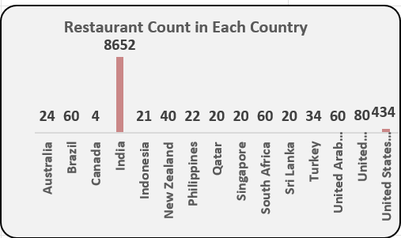
The number of restaurants opened in each country
India is having the highest number of restaurants i.e. 8652
Second place is occupied by USA with 434 restaurants.
Based on the chart except India and USA all countries are less number of Restaurants.
Except India and USA Remaining Countries Quite good choice for Newer Restaurants.

Slide 8
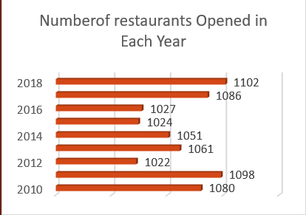

The number of restaurants opened each year
Highest number of restaurant was opened in year 2018.
Least number of Restaurant was opened in the year 2012.
However the Year wise Count of Restaurants will not effect the choose of Countries for opening newer Restaurants.

Slide 9
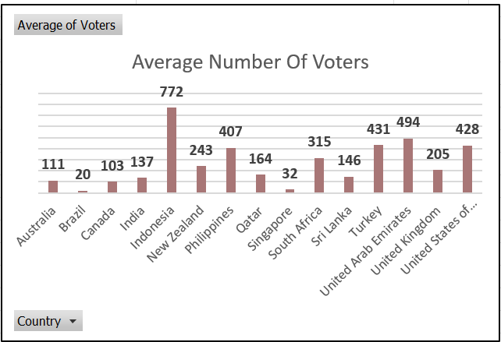
The average number of voters for the restaurants in each country
Indonesia is having the highest number of voters in restaurants, followed by UAE, Turkey and USA
As compare to number of restaurants in India, the number of voters are very less.
Choosing the Countries with high number of voters with a top rating Restaurants is a good choice for opening newer Restaurants
High average voters shows the Customer interest in the Restaurants

Slide 10
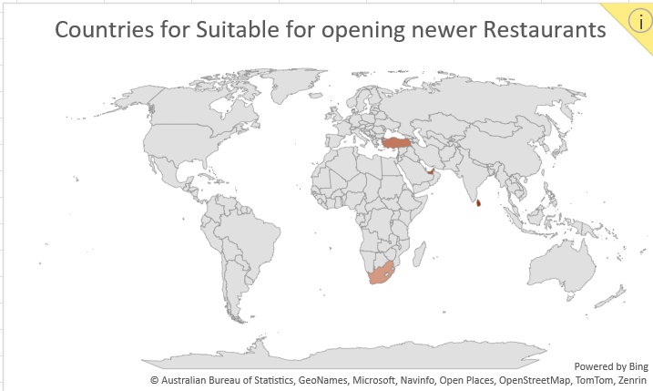

Countries Suitable for opening Newer Restaurants
Most suitable countries (cities) for opening new restaurants based on criteria where total number of restaurants are less than 100, average ratings are 3.9 or higher, with less than Rs 6000 average expenditure for two person to have a meal and number of voters higher than 140 are :
South Africa, Sri Lanka, Turkey, News Zealand, Qatar and UAE.

Slide 11
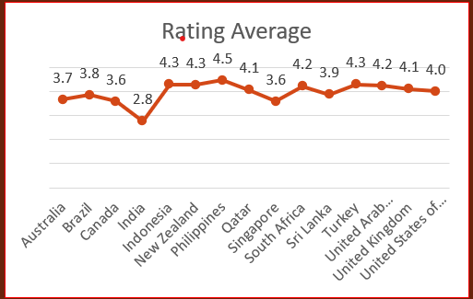

The current quality regarding ratings for restaurants that are open there
We are able to analyse that the selected countries having better rating that are above 3.9
New Zealand – 4.3
Qatar – 4.1
South Africa – 4.2
Sri Lanka – 3.9
Turkey - 4.3
United Arab Emirate – 4.2
However the Sri Lanka having rating below 4,by providing online delivery and table booking facility, making it a strong candidate for opening newer restaurants there.

Slide 12

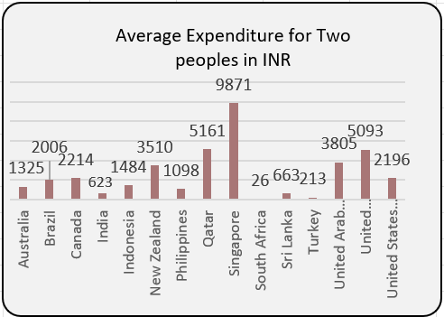
Country wise expenditure analysis
Budget control is more difficult in Singapore, Qatar, and the United Kingdom due to their much greater costs associated with expenditure management.
In Sri Lanka, Turkey, India, Indonesia, and South Africa have much lower expenditure management costs. For our filtered countries, with an average expenditure below 6000 INR, we can effectively manage and control our budget.

Slide 13
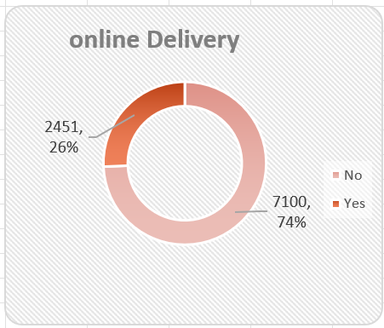
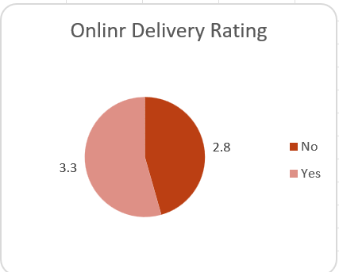
Online delivery analysis and recommendation
Out of the total records, 2,451 Restaurants (around 26%) offer an online booking option, with limited support across countries.
Enhancing online delivery services tends to result in higher ratings, indicating positive customer response to this feature.
Customer feedback has shown a positive response to online delivery services, demonstrating that improving online delivery will enhance customer satisfaction and ratings."

Slide 14
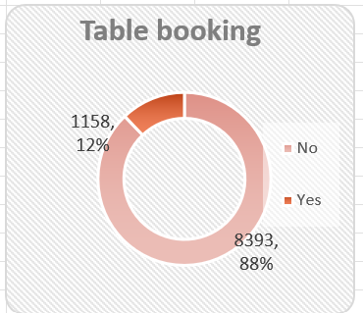
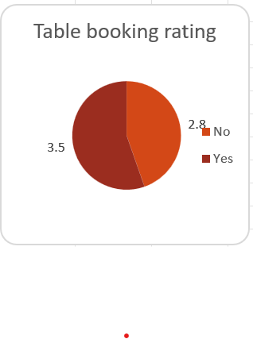
Table booking analysis and recommendation
Among the records, 1,158 Restaurants (12%) offer a table booking option.
providing table booking services is associated with higher ratings, reflecting positive customer feedback.
Due to positive response to table booking services, suggesting that offering table booking will enhance customer satisfaction and overall ratings.

Slide 15
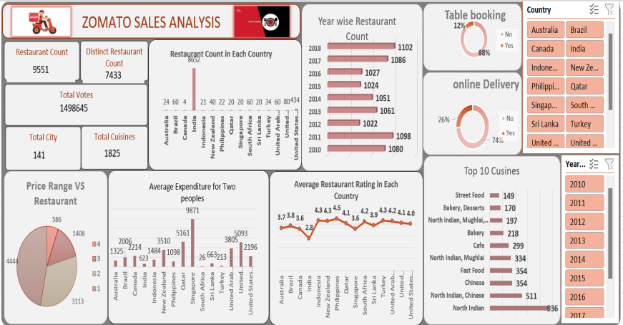
DASHBOARD

Slide 16

Cities/States in the Country suitable for opening new Restaurants
Based on the analysis the below cities in the selected Countries are most suitable for opening newer Restaurants.
South Africa: Cape Town, Inner City, Johannesburg, Pretoria, Randburg, Sandton
Sri Lanka: Colombo
Turkey: Ankara, Istanbul
New Zealand: Auckland, Wellington City
Qatar: Doha
UAE: Abu Dhabi, Dubai, Sharjah

Slide 17
Conclusion
In conclusion, our review of Zomato's restaurant data shows good opportunities for expanding globally. By focusing on areas with high demand, adjusting services to fit the needs of different customer groups, and using our competitive advantages, we confidently recommend opening new restaurants. This strategy will not only grow Zomato's market presence but also offer better dining experiences, helping Zomato grow sustainably and improve the global food scene.

Slide 18


